Slide 1
DIGITAL PORTFOLIO
STUDENT NAME: RAJMAYIL.R
REGISTER NO AND NMID: astvu 35635624u09034
DEPARTMENT: BCA-II YEAR
COLLAGE: GASC/THIRUVALLUR UNIVERSITY

Slide 2


Slide 3


Slide 4
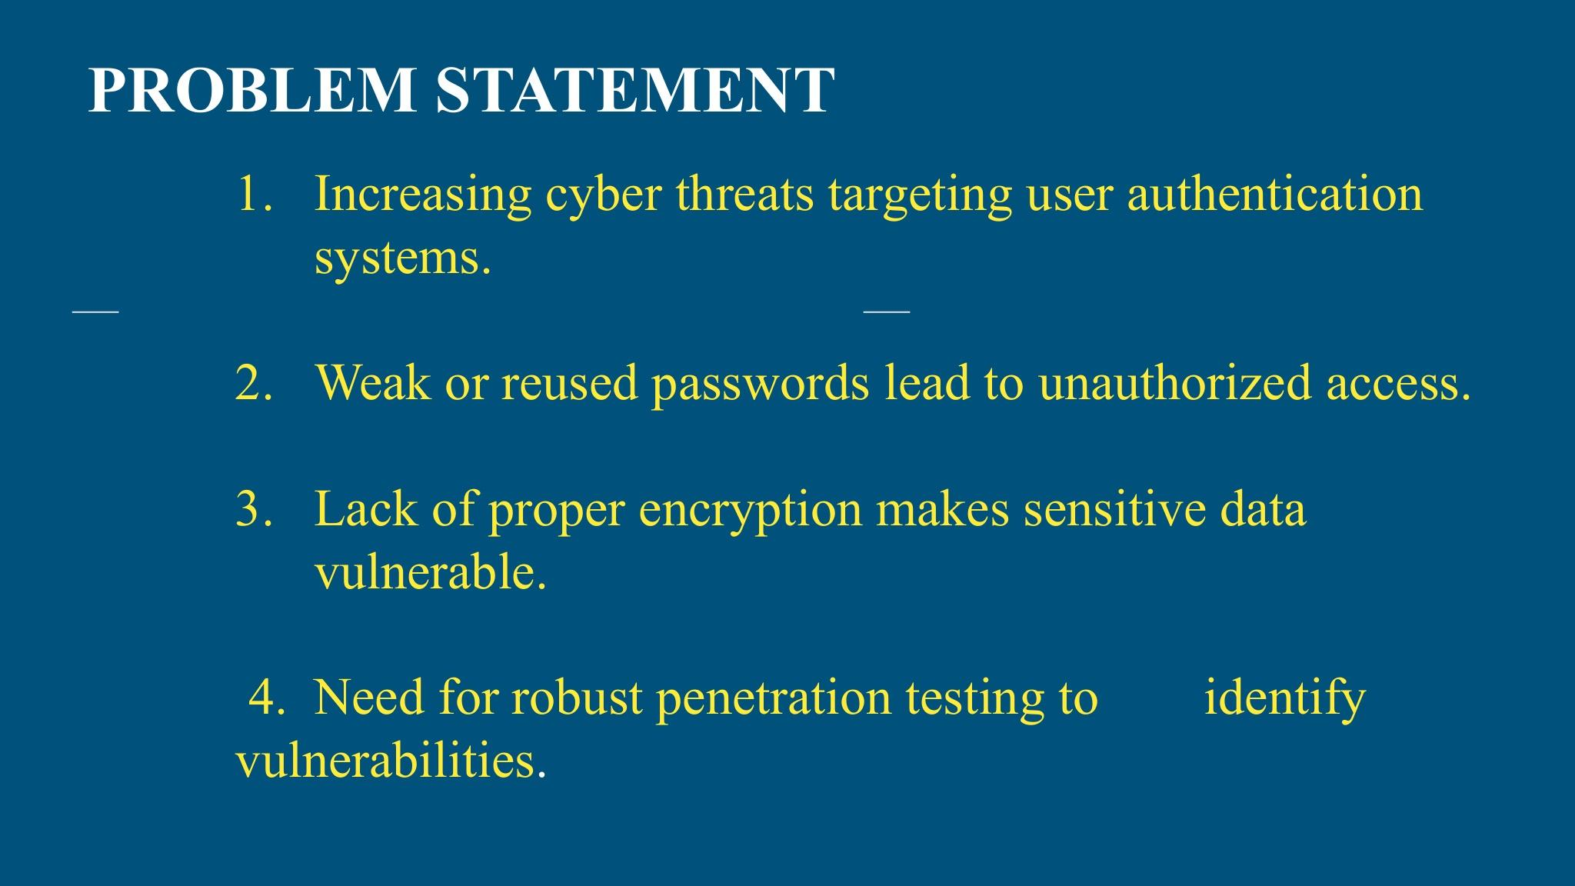

Slide 5


Slide 6
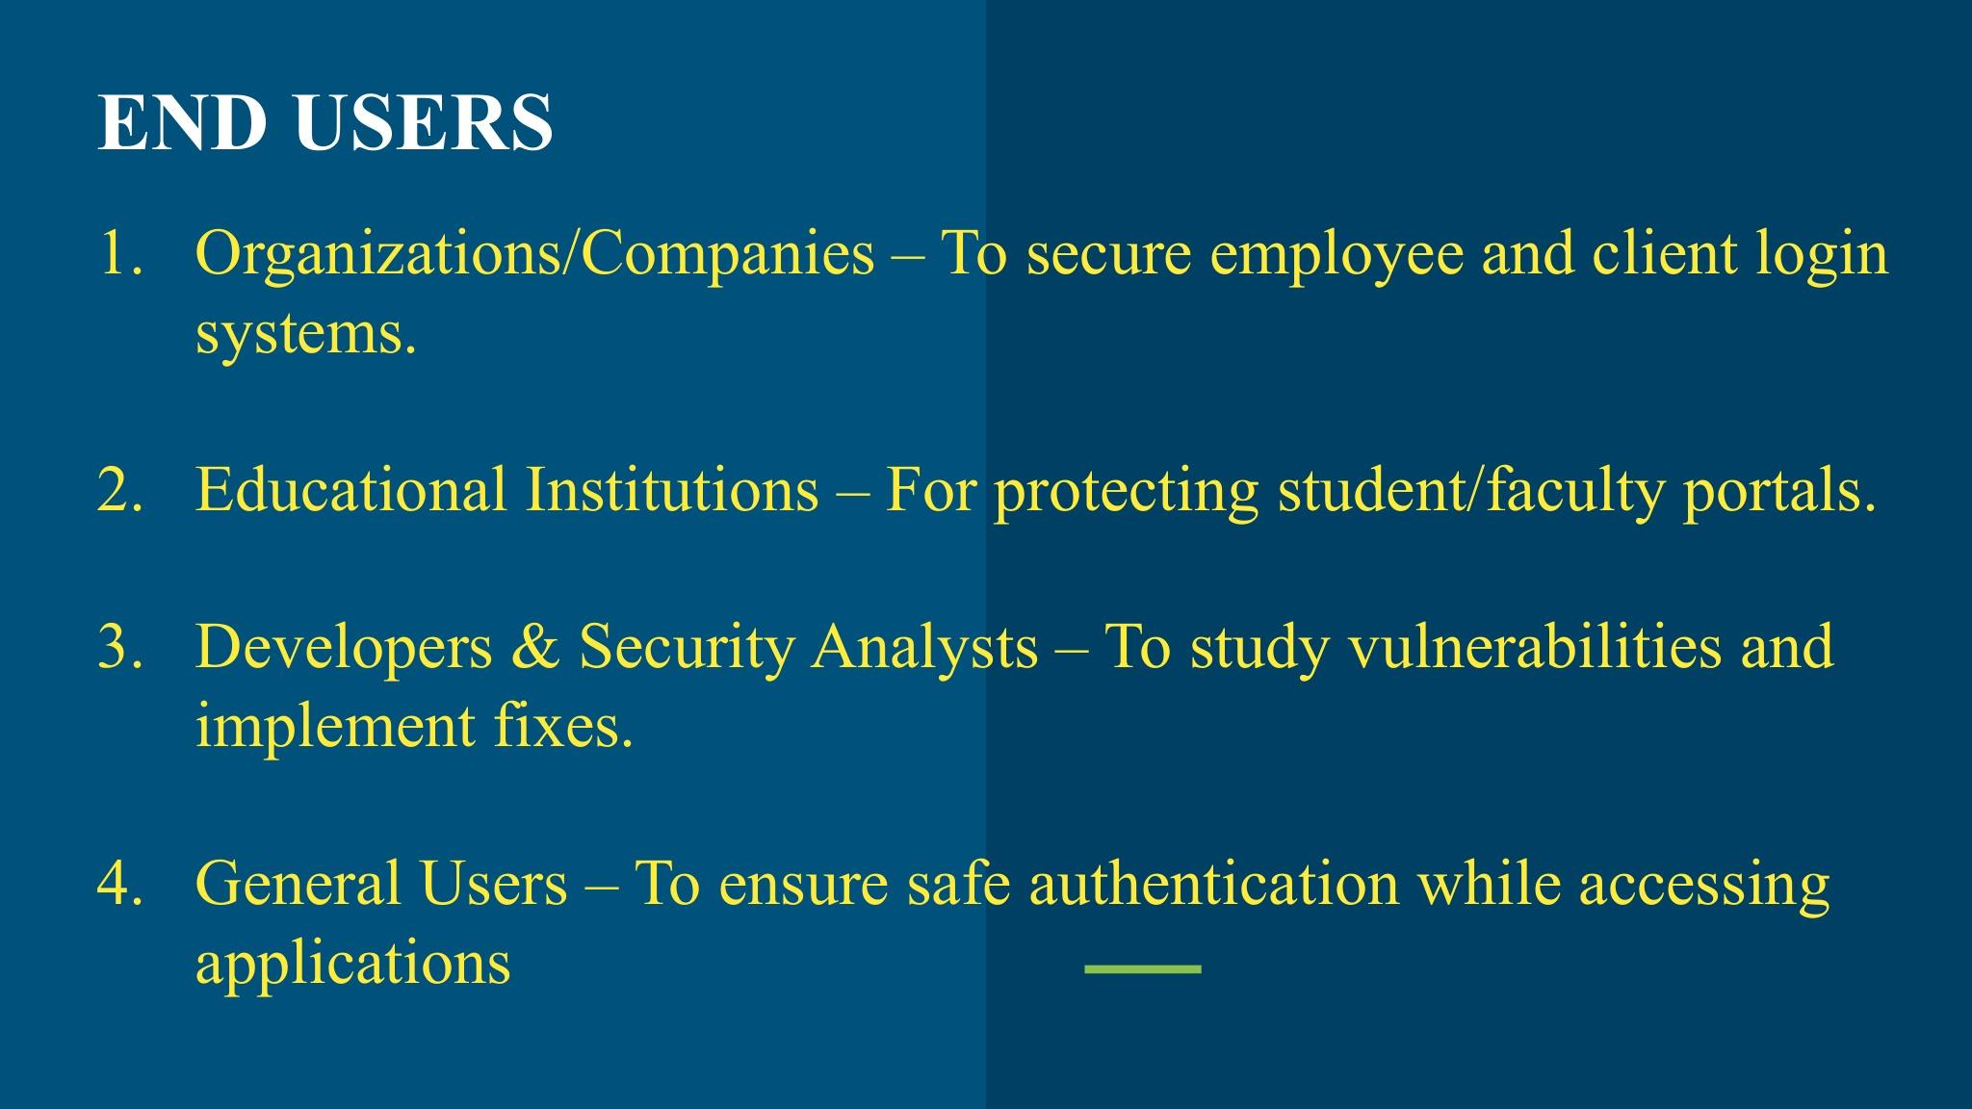

Slide 7


Slide 8
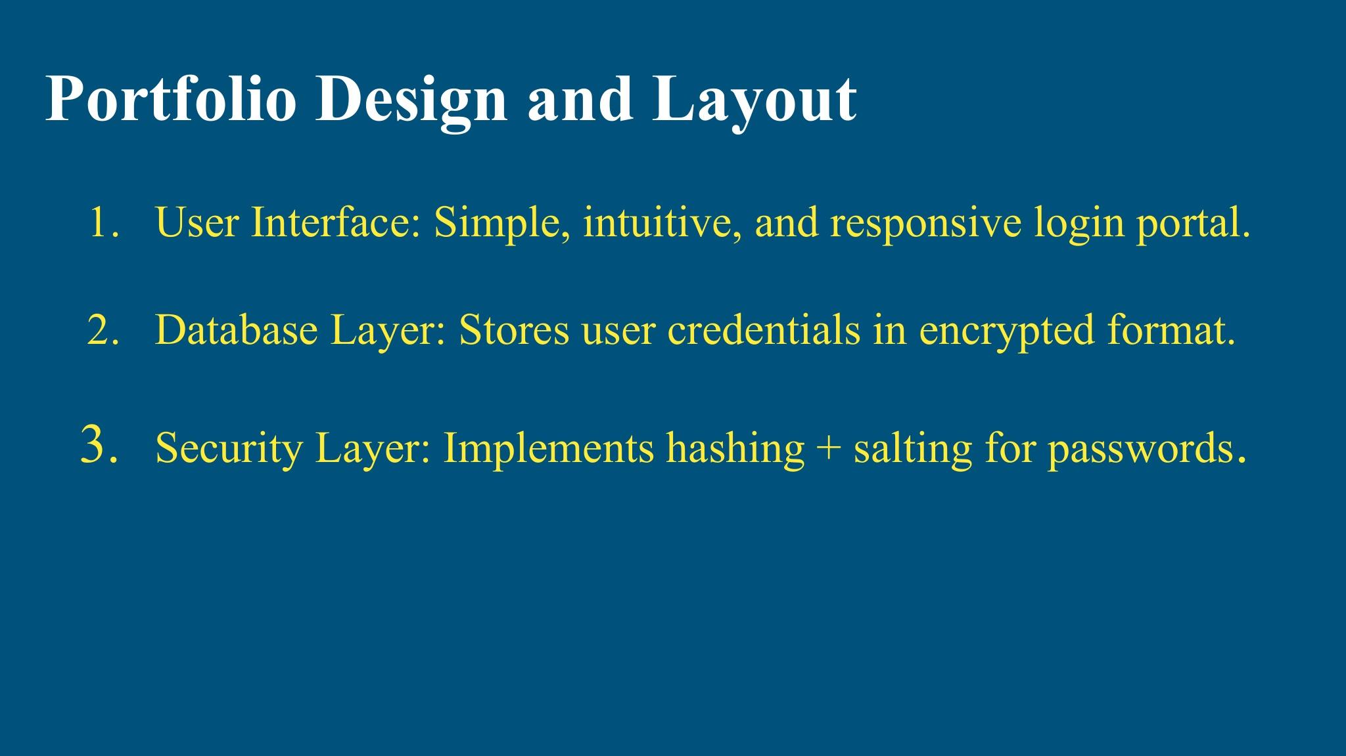

Slide 9
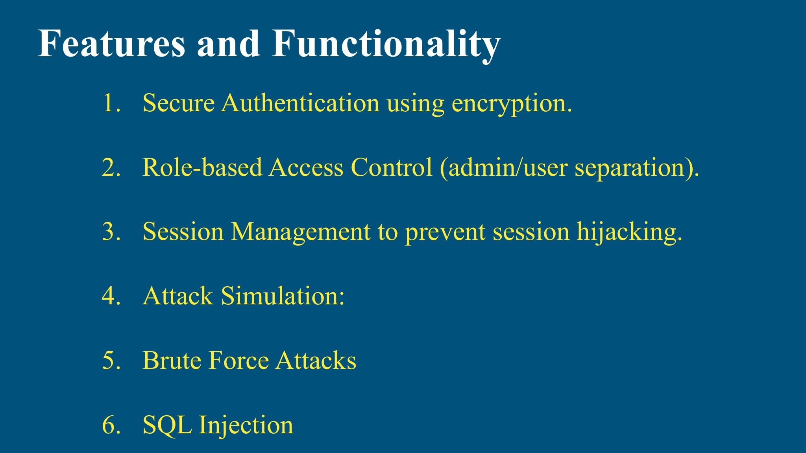

Slide 10
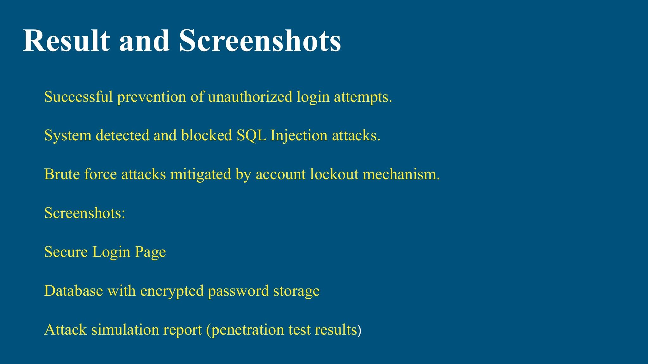

Slide 11
